Slide 1

iGOAT
One goat saw it coming

Slide 2


Scientists: Jonas, Marvin, Max, Nicolas

Slide 3

Website
igoat.mendes.dev

Slide 4
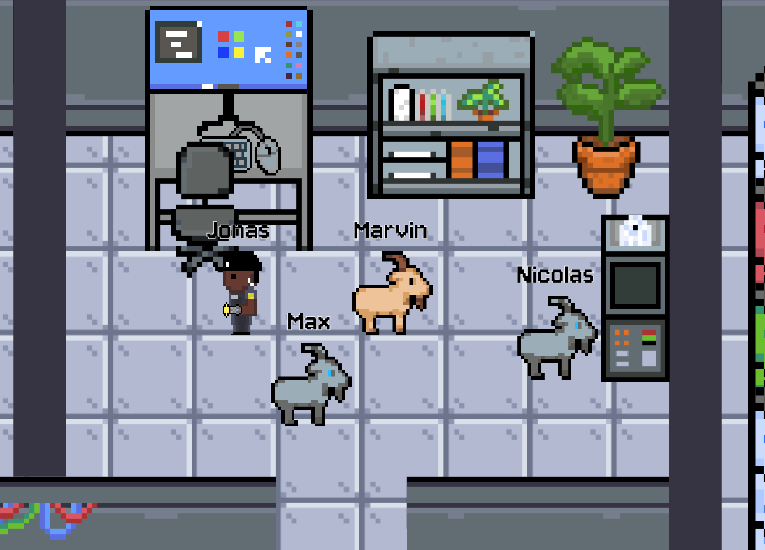
DEMO

Slide 5
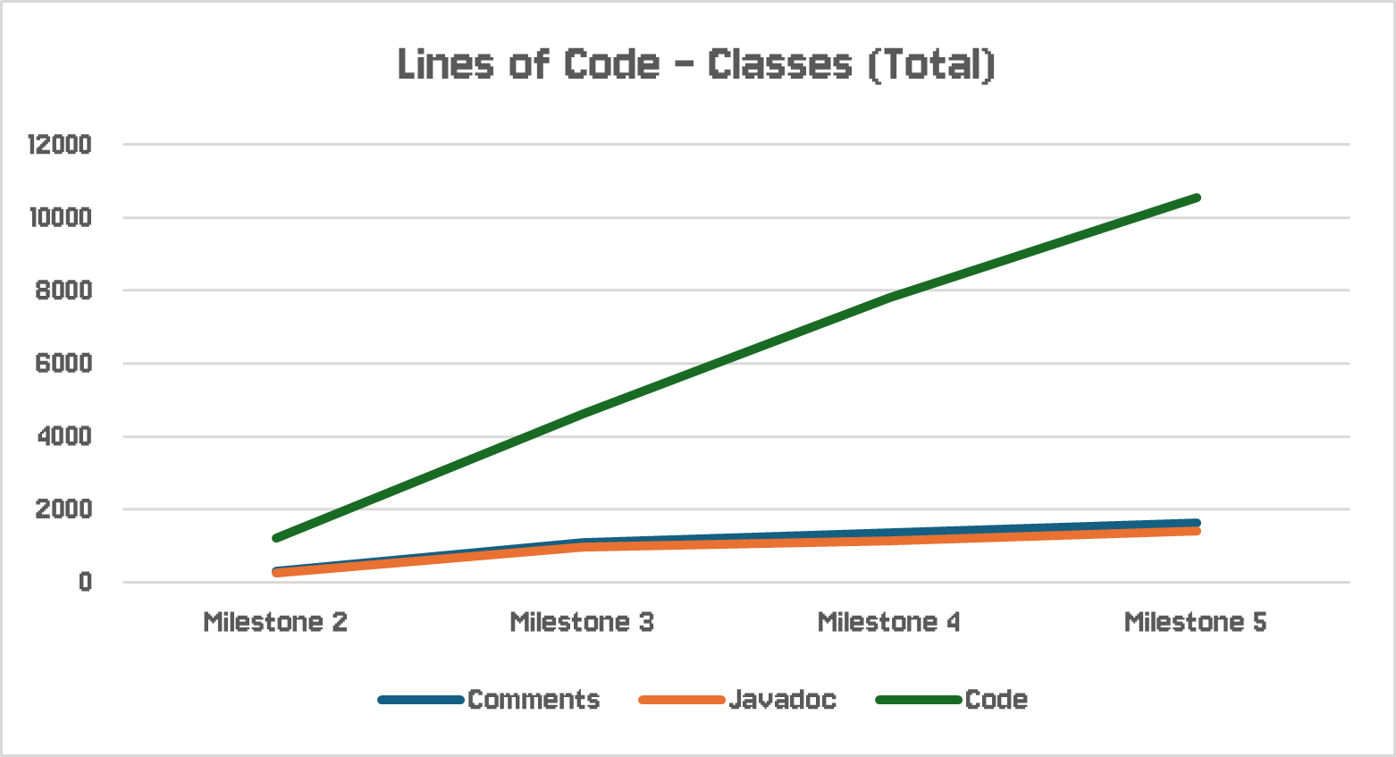
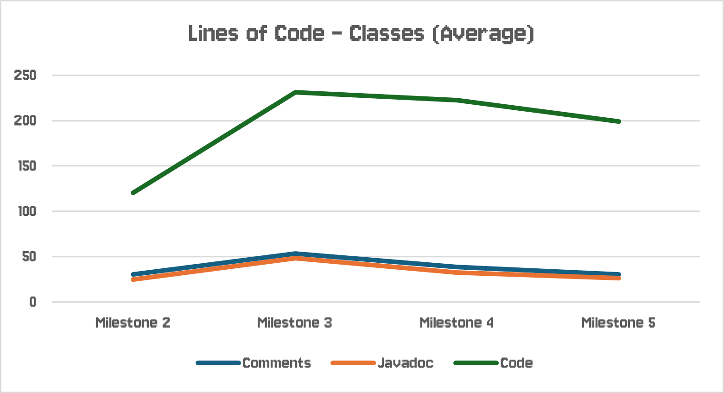
Quality Assurance: Lines of Code (Classes)

Slide 6
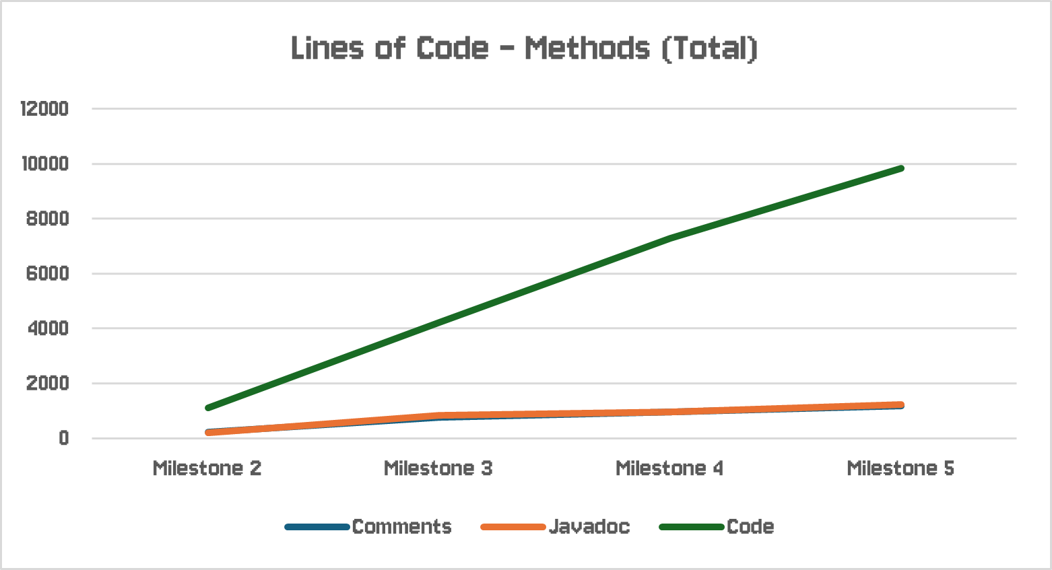
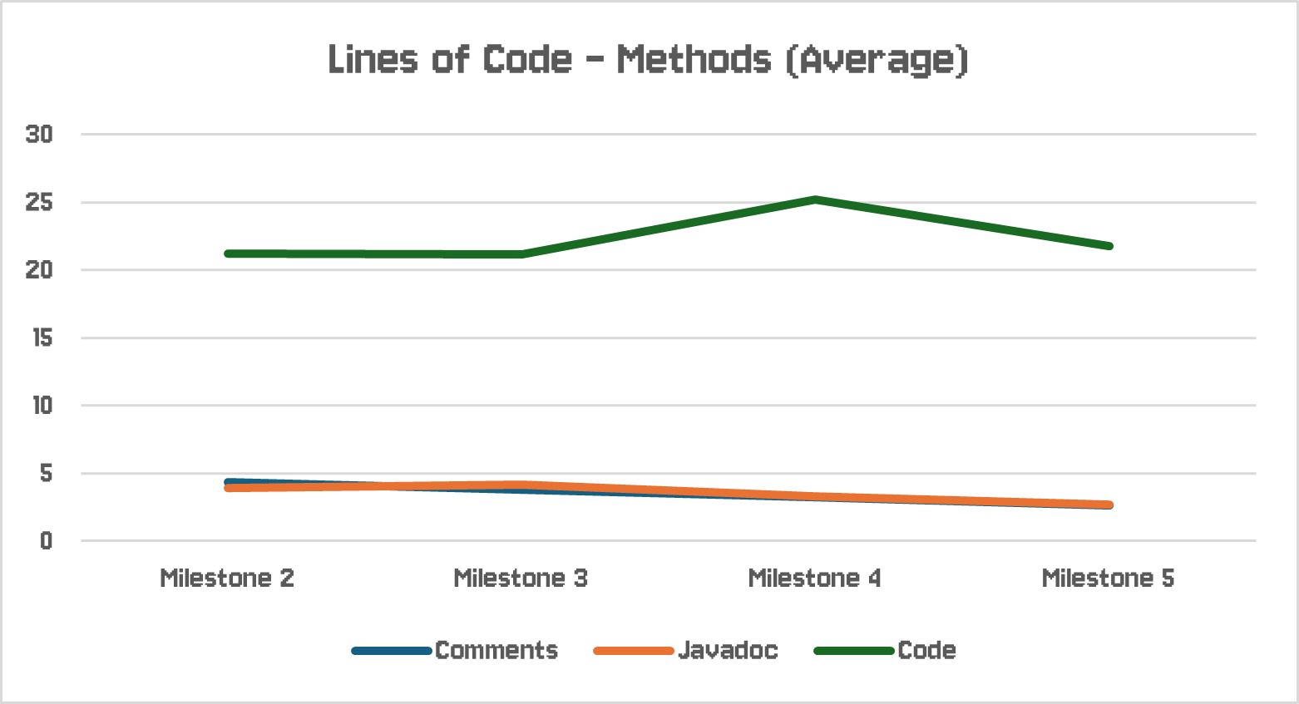
Quality Assurance: Lines of Code (Methods)

Slide 7
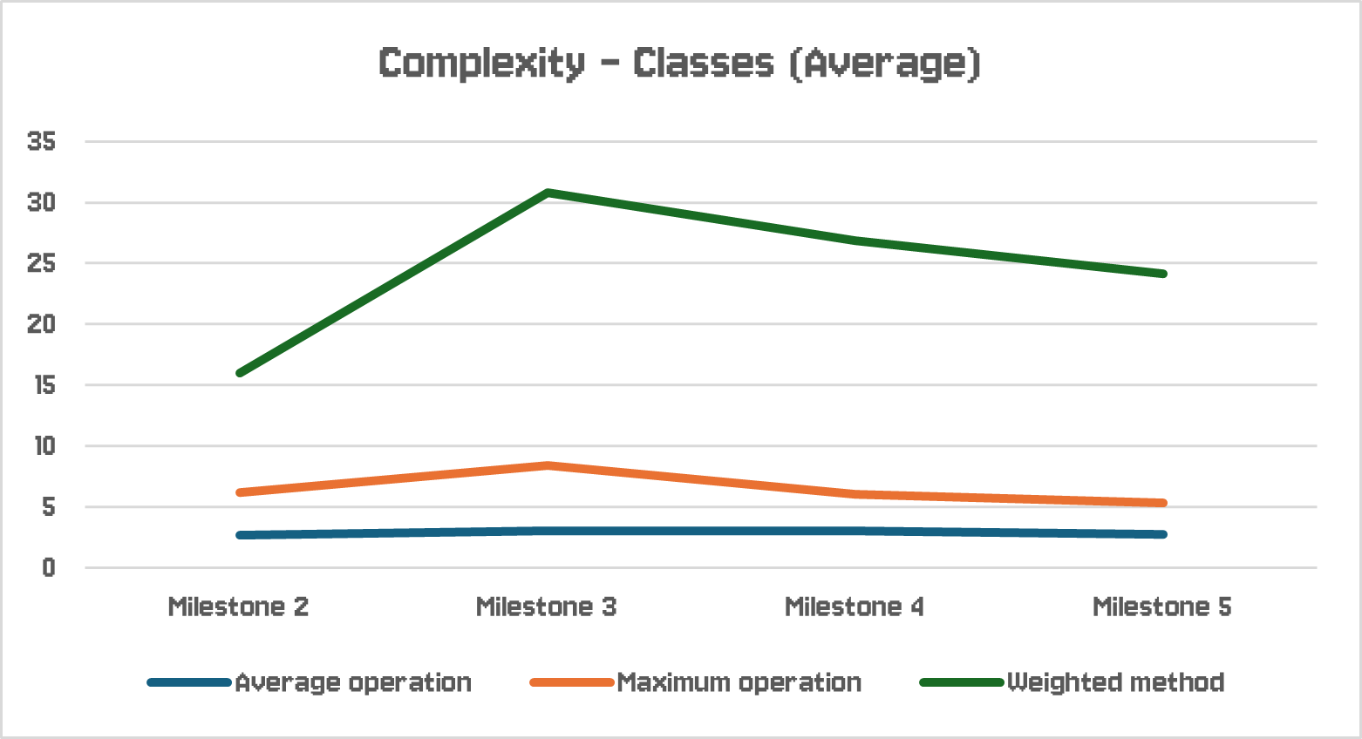
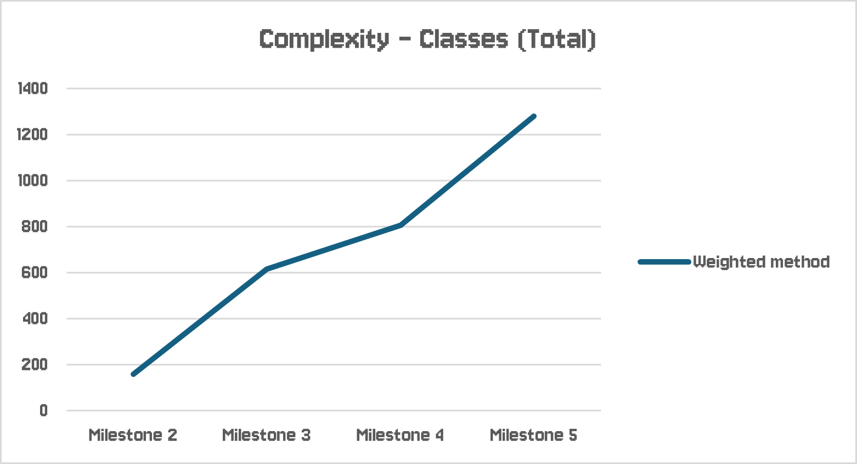
Quality Assurance: Complexity (Classes)

Slide 8
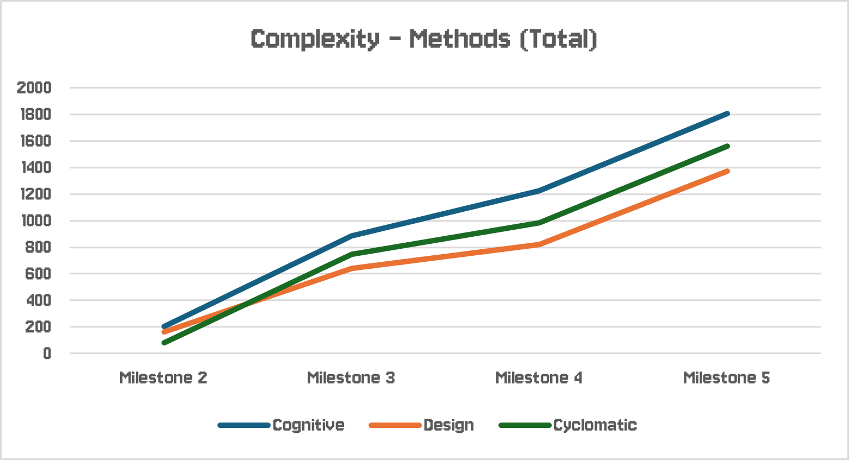
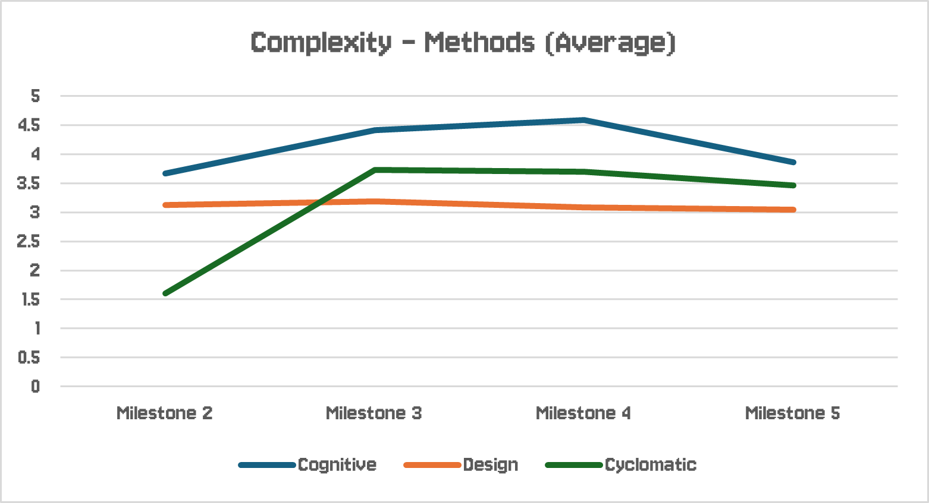
Quality Assurance: Complexity (Methods)

Slide 9
Lessons Learned
Code structure
git usage
Bug testing
Communication
Time management
Team work

Slide 10

Questions?

